Slide 1
Main Figures

Slide 2
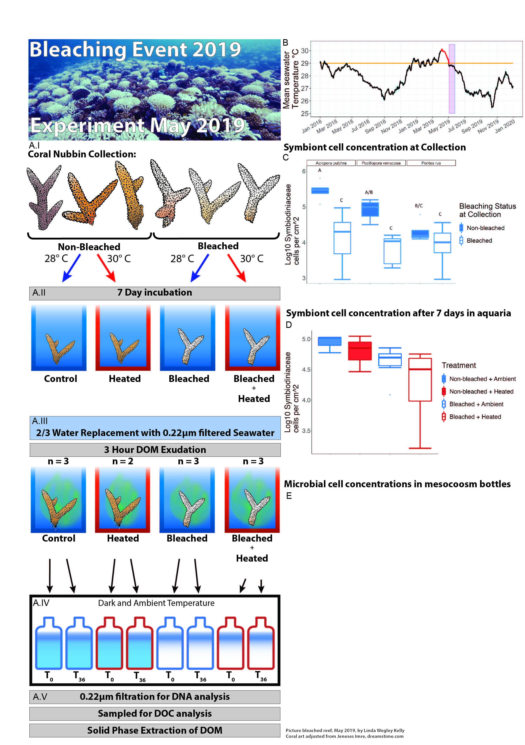
Figure 1: Field collections and experimental design. Non-bleached and bleached corals were collected from a reef in Mo’orea, French Polynesia immediately following a bleaching event. A) Picture of the LTER1 fore reef in Mo’orea, French Polynesia representative of the status of the reef where both bleached and non-bleached corals were present. A.I-A.V) depict the experimental design and sampling from corl nubbin collection (A.I), 7 day pretreatment in flow through aquaria (A.II), DOM exudation (A.III), 36 hour dark bottle incubation (A.IV), and sampling (A.V). B) Mean seawater temperatures over the period from January 1st 2018 until December 31st 2019 from 3 fore reef LTER sites. The Mo'orea Coral Reef Long Term Ecological Research (MCR LTER) daily average water temperature data time series was combined from 3 sites on the MCR LTER fore reef: FOR1, FOR4 and FOR5 (GPS location: 17°28'30.0"S 149°50'13.2"W; 17°32'49.2"S 149°46'08.4"W; 17°34'55.2"S 149°52'30.0"W; respectively). From each location data from five sensors (“upper water column”, “middle water column”, “bottom water column”, “temperature shallow”, and “temperature deeper”) was used to calculate the average temperature +/- 1 standard deviation. Standard deviation depicted in blue. The orange line indicates the thermal stress accumulation threshold level of 29°C. Bleaching was first observed in April 2019, indicated by the start of the red line, which continued until the temperature levels dropped under the thermal stress accumulation threshold. The experiment, indicated by the purple block, was started immediately after temperatures dipped below the thermal stress accumulation threshold. A subset of collected nubbins were sacrificed after the three day acclimatization period for symbiont cell concentration analysis to validate the observed bleaching status at collection (C). Healthy corals had significantly higher symbiont levels compared to bleached corals (two-way ANOVA, F=45.552, p=2.67e-08). After 7 days in the aquaria the 4 coral treatments had varying degrees of bleaching/paling with healthy at ambient temperatures having the highest concentrations, although these differences were not statistically significant (one-way ANOVA, F=2.623, p=0.123) (D). Microbial communities responded to DOM amendments by growing to significantly higher concentrations after incubating for 24 hours (one-way ANOVA, F=54.09, p=2.3e-08).

Slide 3
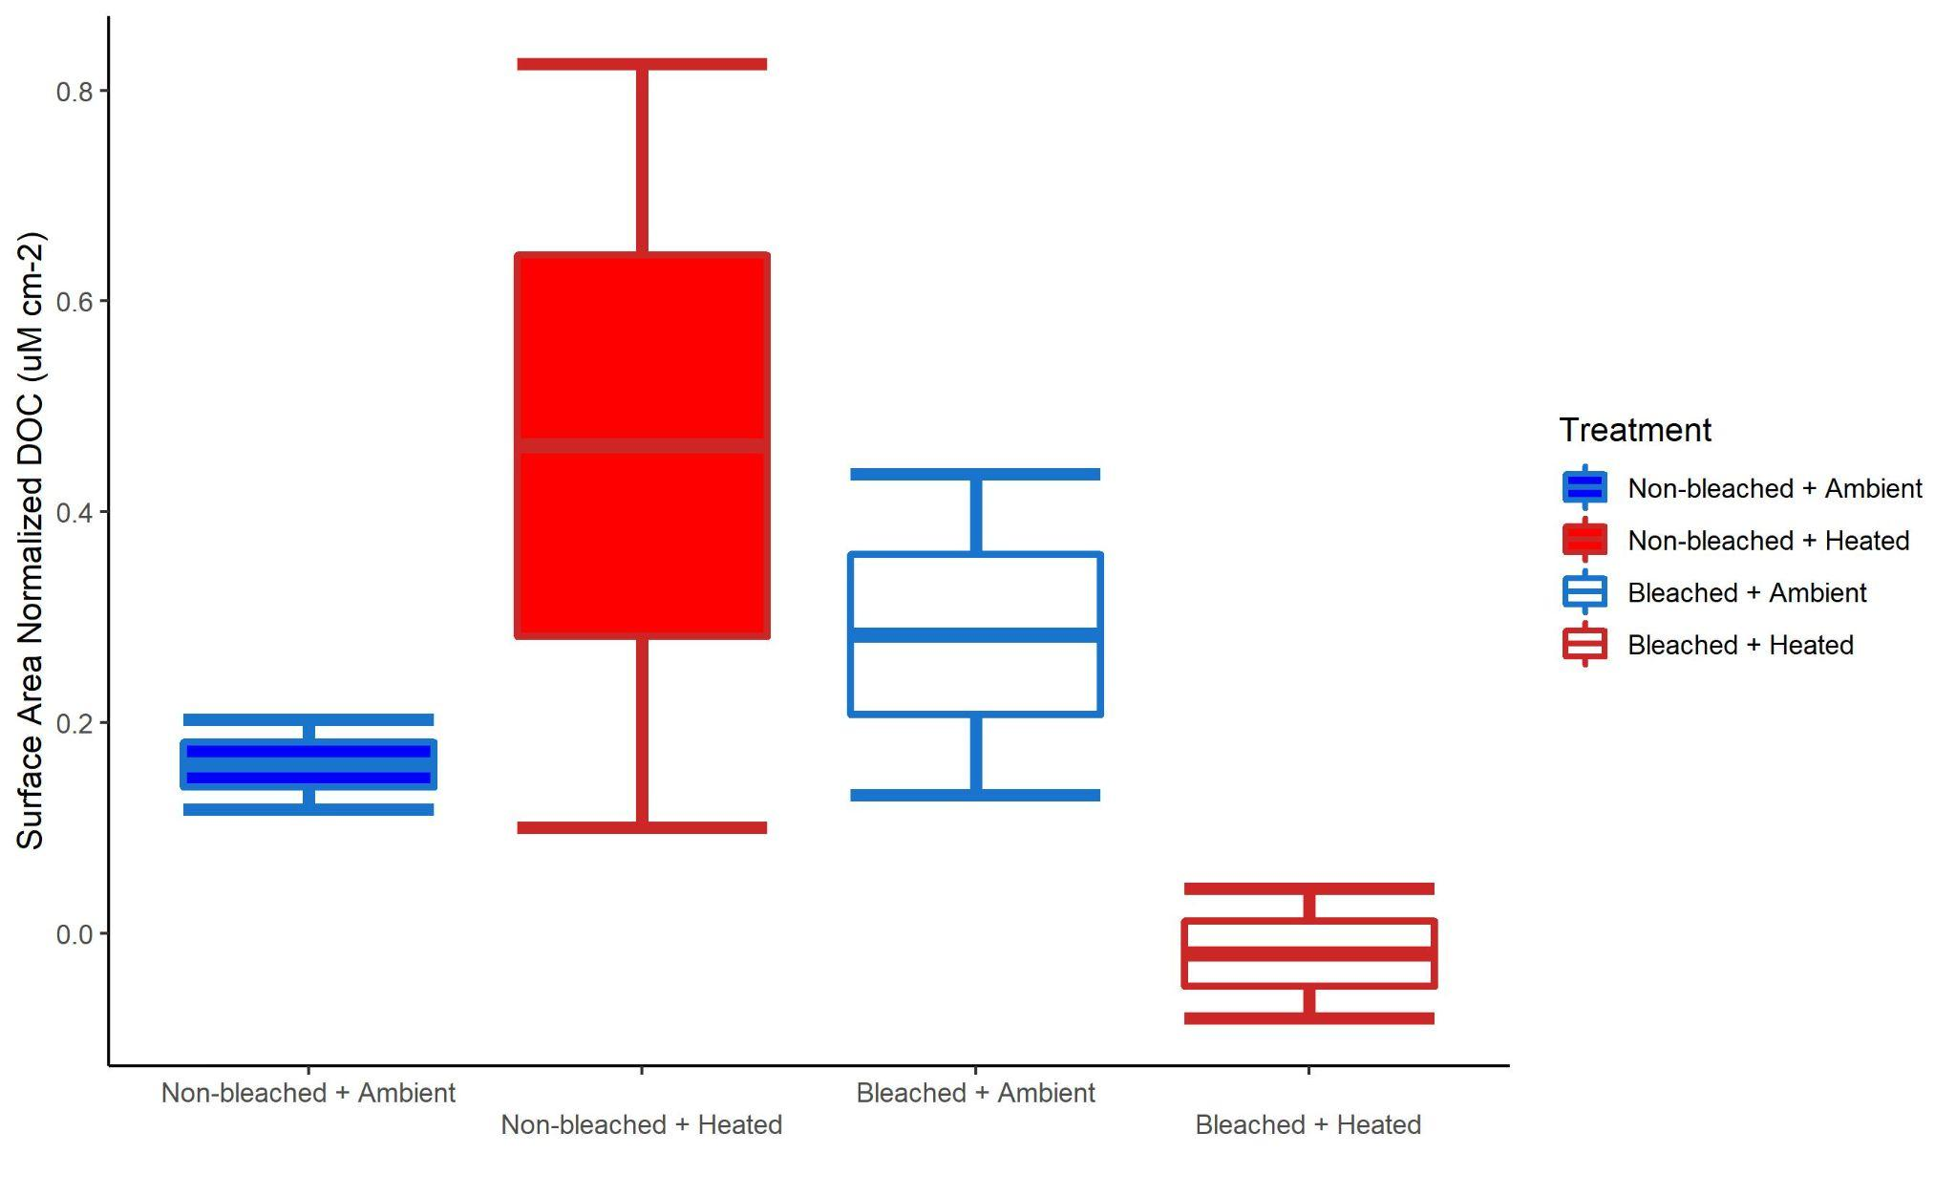
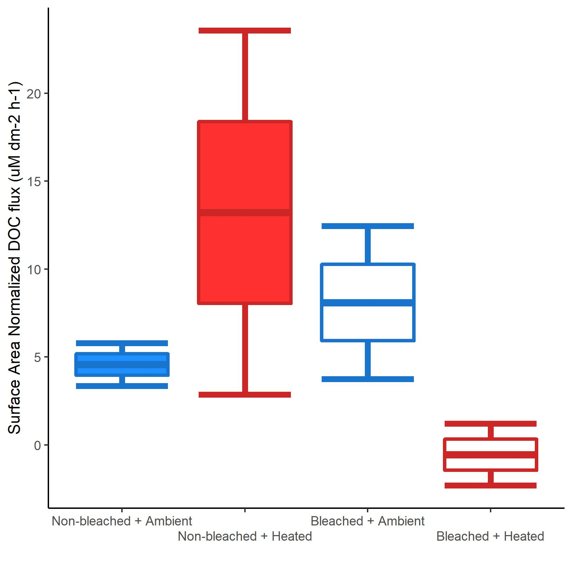
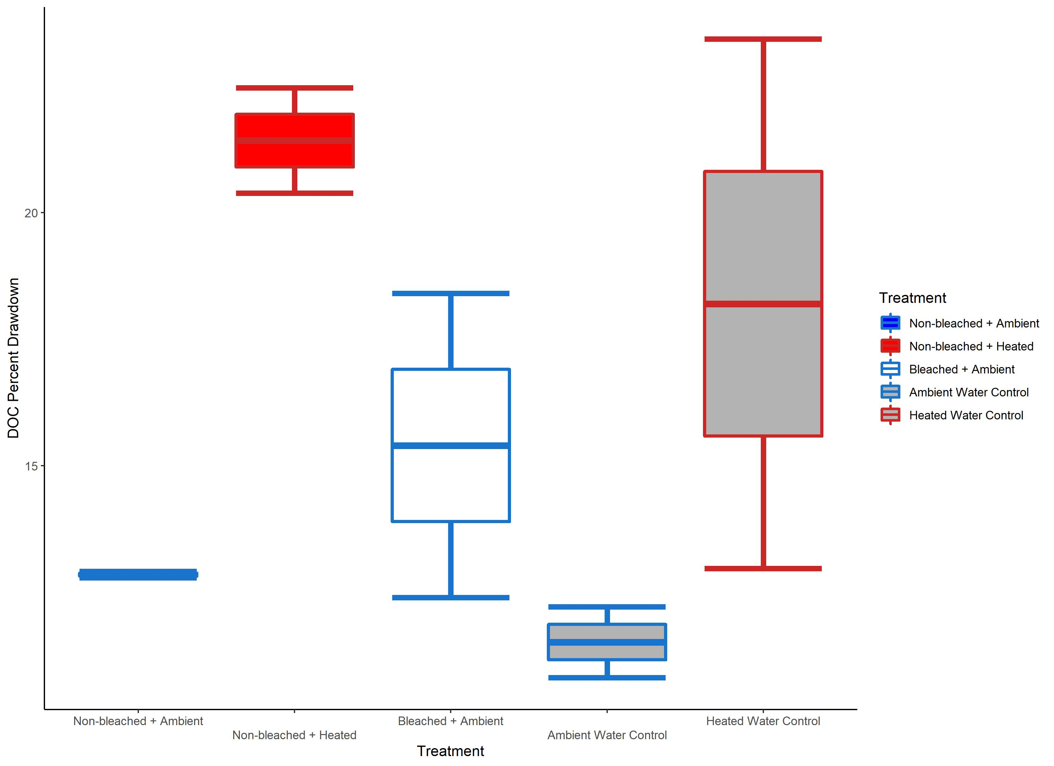
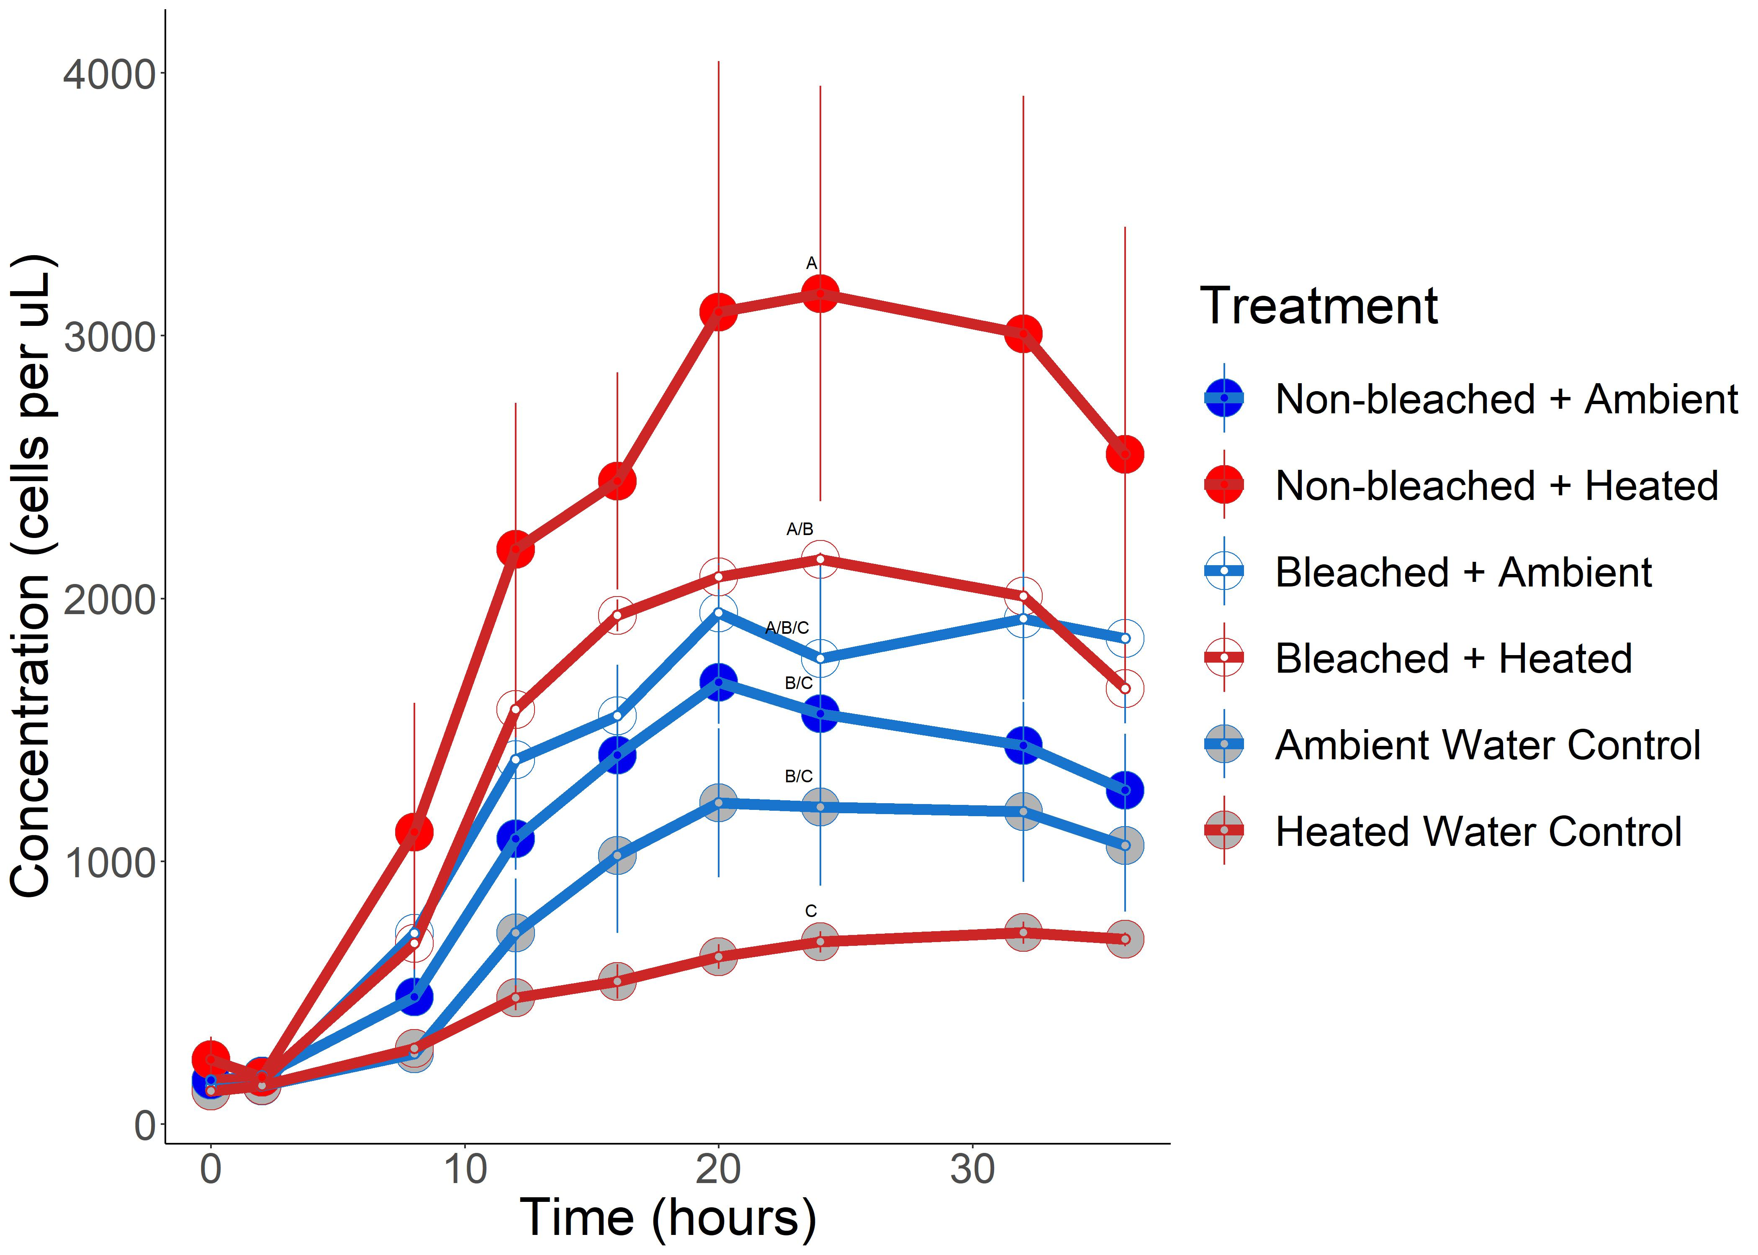
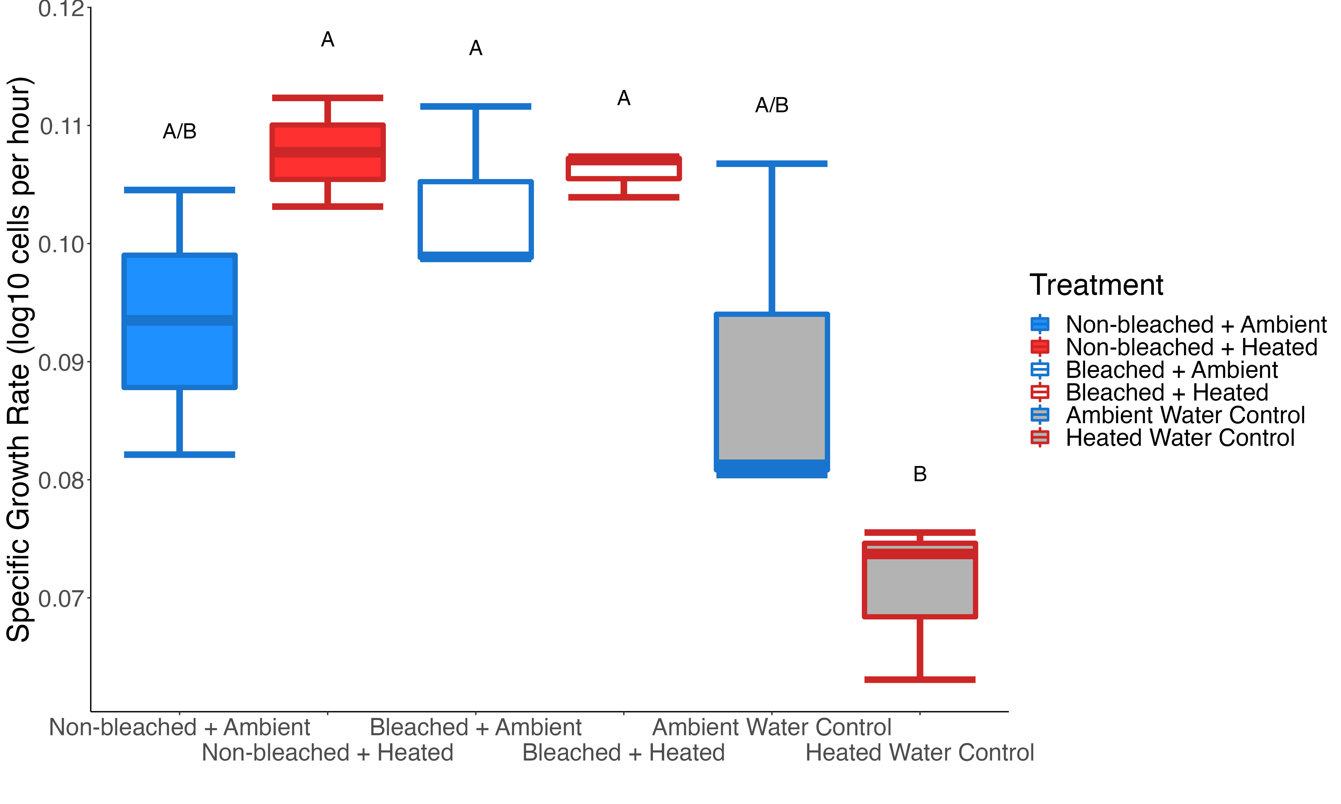
A
B
C
D
Figure 2: Box and whisker plots of surface area normalized DOC concentrations for the 4 coral treatments (A). Box and whisker plots of the DOC drawdown (%) for each treatment after the 36 hour incubation. “Bleached + Heated” is excluded due to loss of samples from DOC contamination (B). Bacterial growth curves for the 6 treatments in the 36 hour bottle incubation, error bars indicate standard error of the mean (C). Box and whisker plots of bacterial specific growth rate, in log10 cells per hour, for the 6 treatments (D).

Slide 4
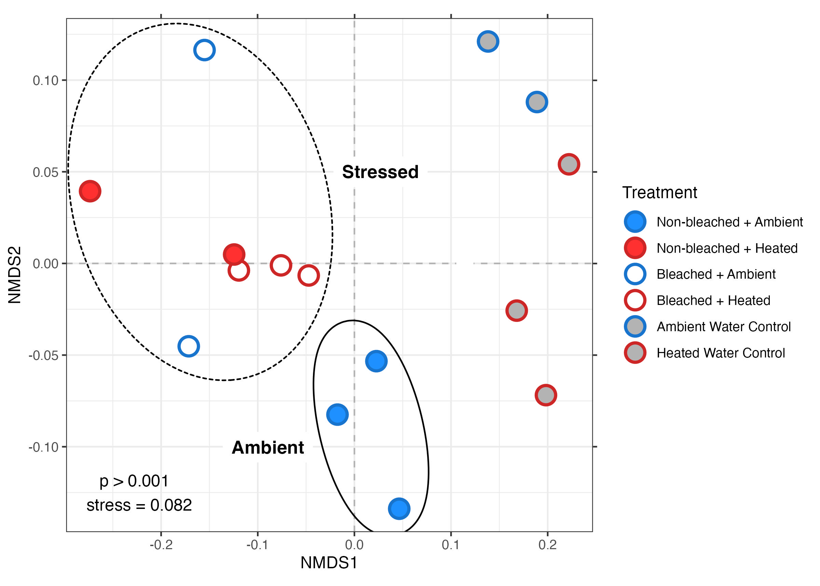
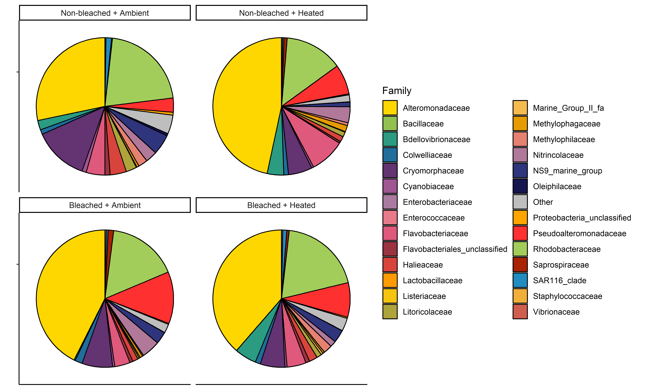
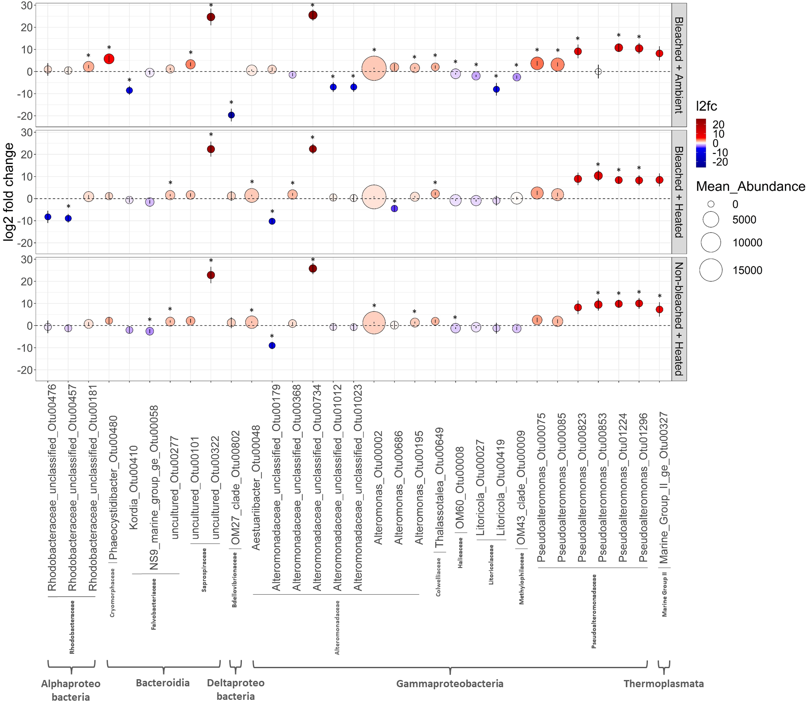
A
B
C
Figure 3: Non-metric multidimensional scaling of multivariate microbial community samples using Unifrac distances derived from 16S amplicon data (A). Pie charts depicting the mean relative abundances of the most abundant bacterial families in the coral treatments (B). Pie charts are colored according to family. Abundant families were defined as families having a relative abundance ≥ .01 in at least one sample. Visualization of the 31 ASVs determined to be significantly differentialy abudant compared to “Non-bleached + Ambient” samples by DESEq2 (C). Dotplot of the log2 fold-change values for the 31 ASVs for the 3 coral stress treatments. Each dot represents a given ASV in a given treatment. Dot height on the y-axis and color correspond to l2fc values. Error bars depict the standard error of each l2fc value calculated by DESEq2. Dot size corresponds to mean raw abundance. Each ASV is labeled according to it’s Class, Family, and Genus_OTUNumber on the x axis. Astrices denote a significantly DA ASV in a given treatment.

Slide 5
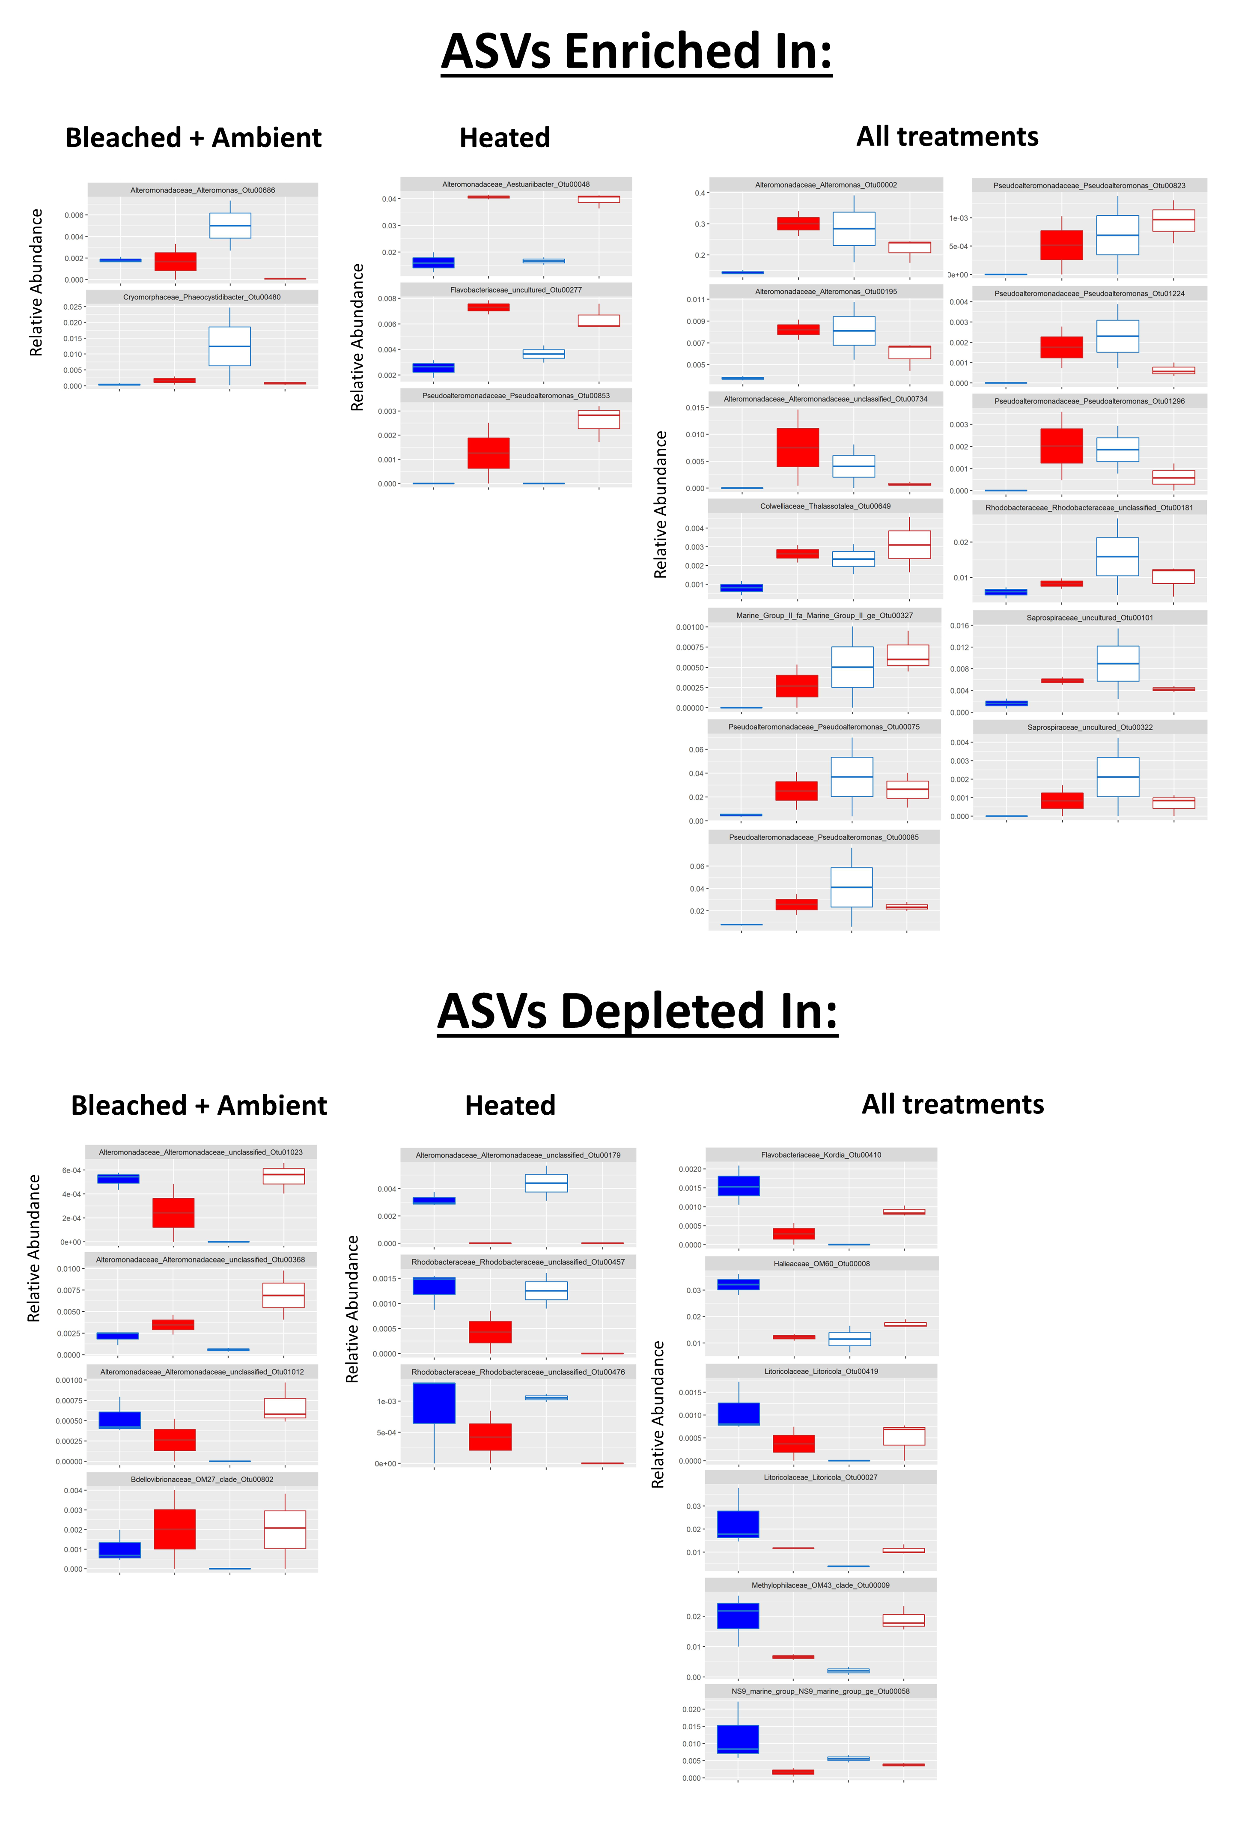
A
B
Figure 4: Boxplots of the relative abundance of significant ASVs enriched (A) or depleted (B) in any of the 3 coral stress treatments relative to the “Non-bleached + Ambient” control. Each plot is labeled accordig to the ASV family, genus, and number. Relative abundance was derived from the non-subsampled, raw abundance data used in DESEq2. Plots are seperated into labled columns indicating which treatment(s) ASVs are enriched in.

Slide 6
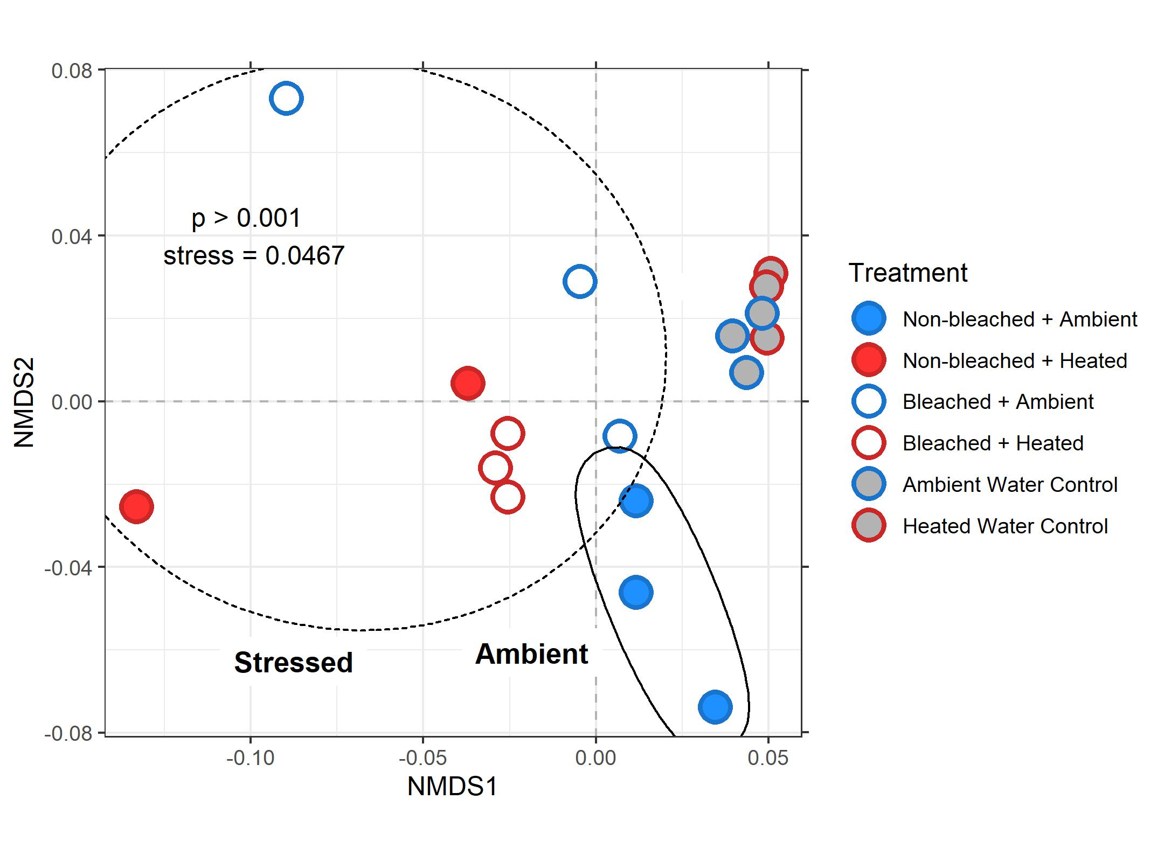
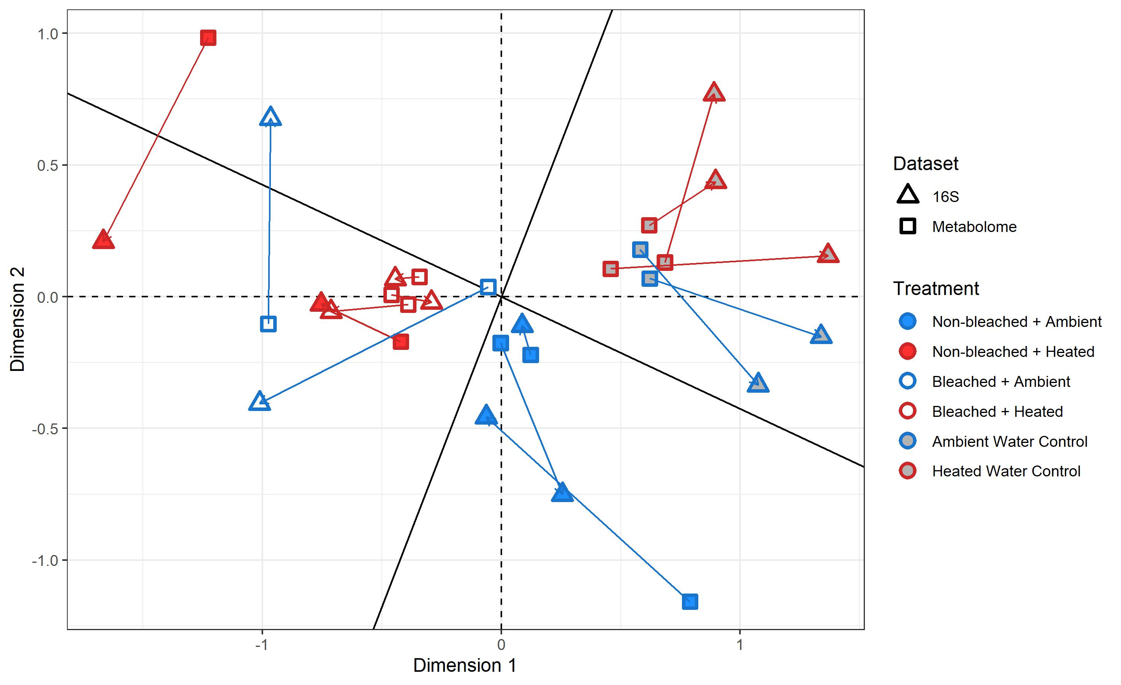
A
B
Figure 5:
Non-metric multidimensional scaling plot of t0 metabolomic samples using bray curtis dissimilarity (A). Procrustes visualization of multivariate metabolomic and microbial samples. Arrows point from microbial samples to corresponding metabolomic samples (B).

Slide 7
Supplemental figures

Slide 8


Control
Sample
Figure S1: Representative density plots of gated SYBR polygon derived bacterial counts for a SYBR stained .2µm filtered milliq control and a SYBR stained sample.

Slide 9
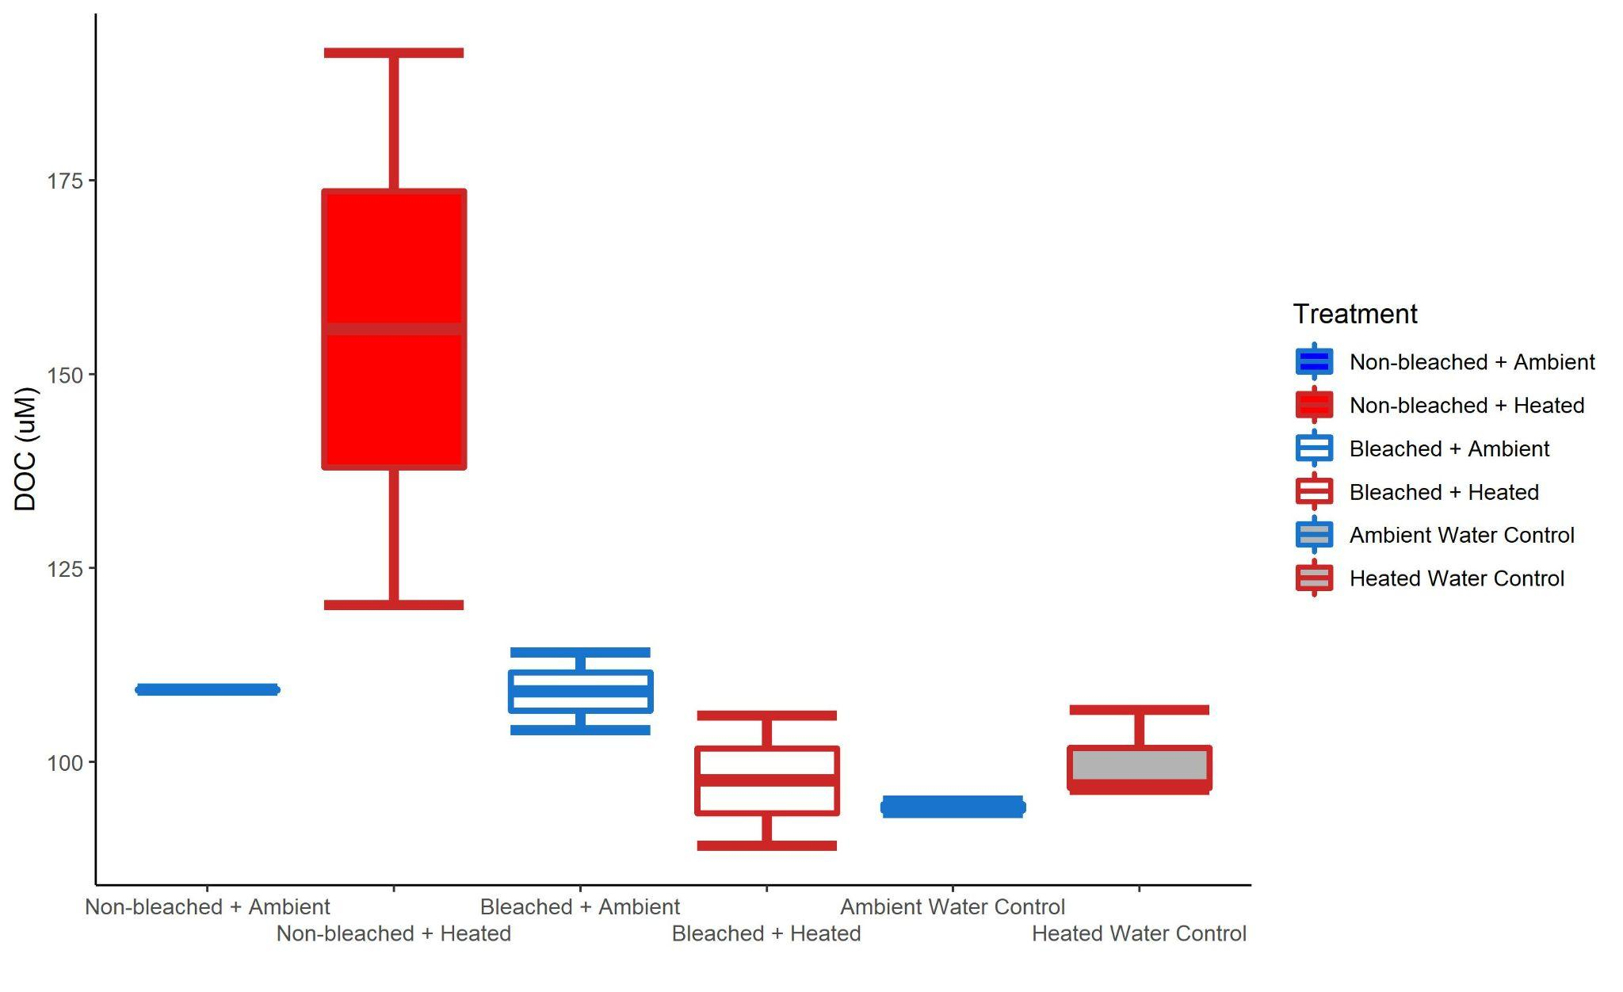
S1
Figure S2: Box and whisker plots of raw DOC exudate concentrations (µM) for the 6 treatments.

Slide 10

Figure S3: Non-metric multidimensional scaling plot of bacterial communities from start and end of bottle incubation using unifrac dissimilarity.

Slide 11
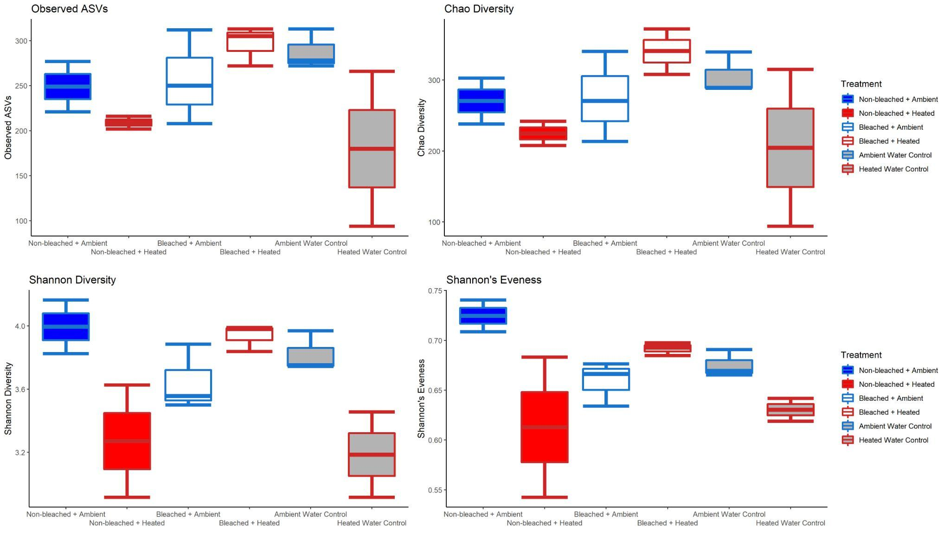
Figure S4: Box and whisker plots of the alpha diversity of the bacterial communities at the end of the incubation

